Slide 1
Migrate SAP IDM to Microsoft Entra

Slide 2
Planning
Reference Architecture
Migration guidance
Licenses Requirement
Learn More

Slide 3
Planning

Slide 4
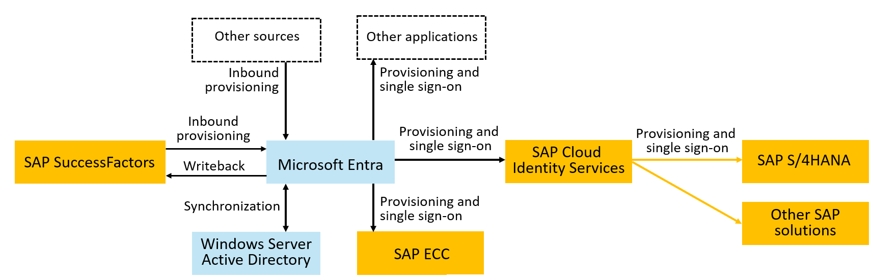
Microsoft Entra and SAP Products Integration

Slide 5
IAM & SAP Modernization: A Strategic Alignment
IAM modernization represents a critical phase within the larger SAP modernization journey.
IAM Scenario Migration: Streamlining identity management by transitioning from SAP IDM to Microsoft Entra.
SAP Modernization: Moving to cloud-based solutions like HCM to SuccessFactors for HCM and SAP R/3 to S/4HANA.
Consolidation: Cleaning up outdated integrations, roles, and access rights.
Customer Journey: Each step, whether adopting SuccessFactors or planning for S/4HANA, is part of the overall modernization direction.

Slide 6
Planning migration
Identify current and planned IAM use cases in IAM modernization strategy.
Analyze the requirements of those use cases and match those requirements to the capabilities of Microsoft Entra services.
Determine timeframes and stakeholders for implementation of new Microsoft Entra capabilities to support migration.
Determine the cutover process for your applications to move the Single Sign-On, identity lifecycle, and access lifecycle controls to Microsoft Entra.

Slide 7
Determine the sequence of application onboarding and how applications integrate with Microsoft Entra
Establish a priority order for applications to be integrated with Microsoft Entra for SSO and for provisioning.
We recommend that organizations that have SAP cloud applications start their integrations with the SSO and provisioning integrations with SAP Cloud Identity Services as middleware.
Confirm how each application integrates with Microsoft Entra
Identify applications that integrate through SAP middleware, E.g:
If you have – or plan to have - SAP S/4HANA, you can use SAP Cloud Identity Services as middleware
If you have SAP ECC integrate Microsoft Entra directly with SAP NetWeaver for SSO and to Business Application Programming Interfaces (BAPIs) of SAP ECC for provisioning

Slide 8
Determine the sequence of application onboarding and how applications integrate with Microsoft Entra
Collect the roles and permissions that each application provides.
Select which roles and groups have membership that are to be governed in Microsoft Entra ID

Slide 9
Define the organization's policy with user prerequisites and other constraints for access to an application
Identify if there are prerequisite requirements or standards that a user must meet before they're given access to an application
Decide how long a user who was approved for access should have access and when that access should go away.
If your organization is already governing access with an organizational role model, plan to bring that organizational role model into Microsoft Entra ID

Slide 10
Define the organization's policy with user prerequisites and other constraints for access to an application
Inquire if there are constraints based on separation of duties
Select the appropriate conditional access policy for access to each application
Decide how exceptions to your criteria should be handled

Slide 11
Decide on Provisioning and Authentication topology
Select the authoritative sources for each identity and their attributes
Decide if users exist or need to be provisioned into Windows Server AD in addition to Microsoft Entra ID.
Decide if you want to use Microsoft Entra ID to provision to SAP Cloud Identity Services or use SAP Cloud Identity Services to read from Microsoft Entra ID.
Decide if you need to provision users into SAP ECC.

Slide 12
Ensure that prerequisites are met
Ensure that your Microsoft Entra ID is ready for the compliance requirements
Compliance is a shared responsibility for Microsoft, cloud service providers (CSPs), and organizations
Use Identity Secure Score to start and implement security best practices
Ensure that your Microsoft Entra ID tenant is properly licensed*
Check that Microsoft Entra ID is already sending Audit Logs to Azure Monitor or SIEM solution as needed*
* Covered later in this doc

Slide 13
Ensure that prerequisites are met
Make sure only authorized users are in the highly privileged administrative roles in your Microsoft Entra tenant
Check that your tenant has appropriate isolation
Evaluate your environment against the security best practices.
Best practices to secure with Microsoft Entra ID - Microsoft Entra | Microsoft Learn
Microsoft Entra security operations guide - Microsoft Entra | Microsoft Learn
Document the token lifetime and application's session settings

Slide 14
Reference Architecture

Slide 15
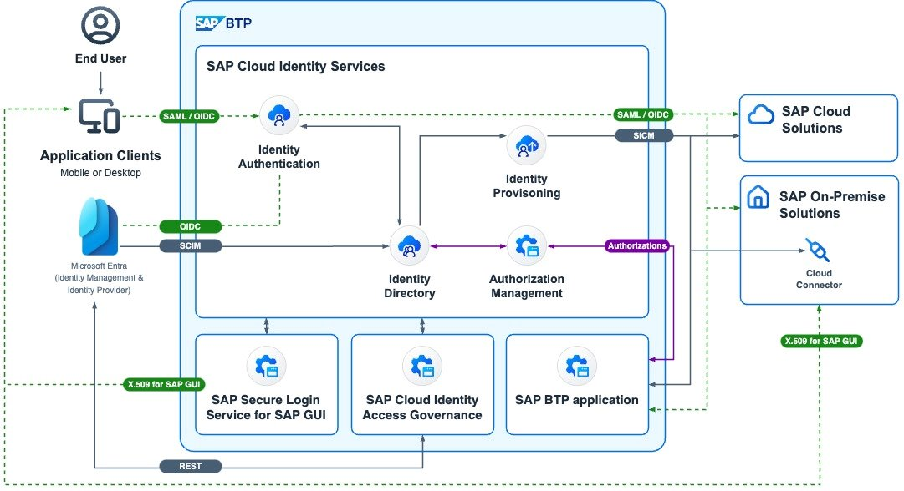
SAP Reference Architecture with Microsoft Entra

Slide 16
Migration Guidance

Slide 17
SAP IDM Scenarios
1. SAP IDM Identity Store
2. User Management in SAP IDM
3. Integrate with SAP SuccessFactor and Other HR sources
4. Provision Identities for SSO in Apps
5. Migrate End User Self-Service
6. Migrate access lifecycle management
7. Reporting
8. Identity Federation (B2B)
9. Directory Services
10. Extensions

Slide 18
SAP IDM Identity Store
SAP IDM Identity Store: A repository containing identity information such as users, groups, and their audit trails.
Microsoft Entra Tenant: An instance of Microsoft Entra ID housing single organization information, including users, groups, and devices. Provides authentication and resource access management.
Microsoft Entra ID will be the “new Identity Store”

Slide 19
SAP IDM Identity Store
In SAP IDM, the Identity Store represents identity data through entry types such as MX_PERSON, MX_ROLE, or MX_PRIVILEGE.
Person in Microsoft Entra ID: Represented as a User, with options to extend the user schema and issue credentials for authentication.
Business Role in Microsoft Entra ID Governance: Represented as an Entitlement Management access package, allowing for governance of application access.
Privilege/Technical Role in Microsoft Entra: Can be represented as an app role or security group, based on the target system’s authorization requirements.
Dynamic Groups in Microsoft Entra: Can be maintained automatically using dynamic groups or entitlement management with automatic assignment policies, with bulk creation via PowerShell cmdlets.

Slide 20
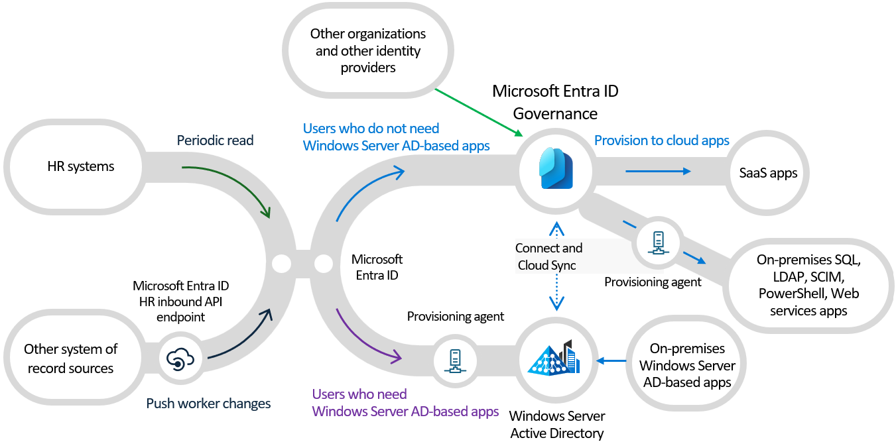
Migrate User Management Scenario
Microsoft Entra enables organizations to automate their Identity Lifecycle process

Slide 21
Integrate with HR Sources
Organizations may have either on-premises HR systems such as SAP HCM or cloud-based HR systems such as SAP SuccessFactors.
Historically, integration with on-premises HR systems for HR driven provisioning leveraged on-premises HR tools such as SAP Identity Management (SAP IDM) or Microsoft Identity Manager (MIM) to create users in Active Directory.
Microsoft Entra ID supports integrating your HR source with both cloud and on-premises.

Slide 22
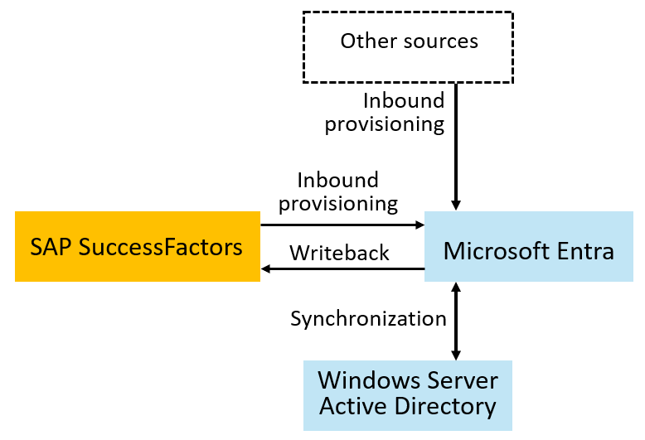
Integrate with HR Sources – SAP SuccessFactors
Organizations with SAP SuccessFactors easily connect to bring identities for employees from SuccessFactors into Microsoft Entra ID or from SuccessFactors into on-premises Active Directory

Slide 23
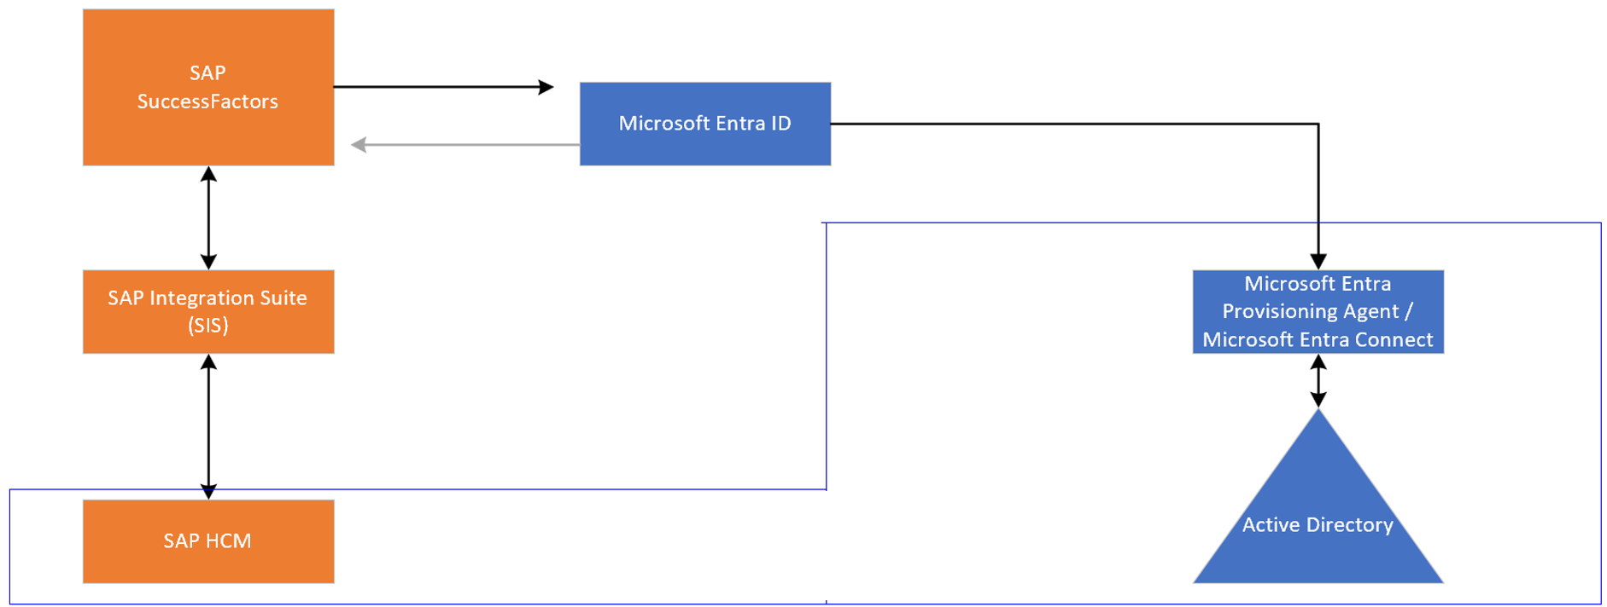
Integrate with HR Sources – SAP HCM + SF
Customers with HCM + SF can leverage this architecture

Slide 24
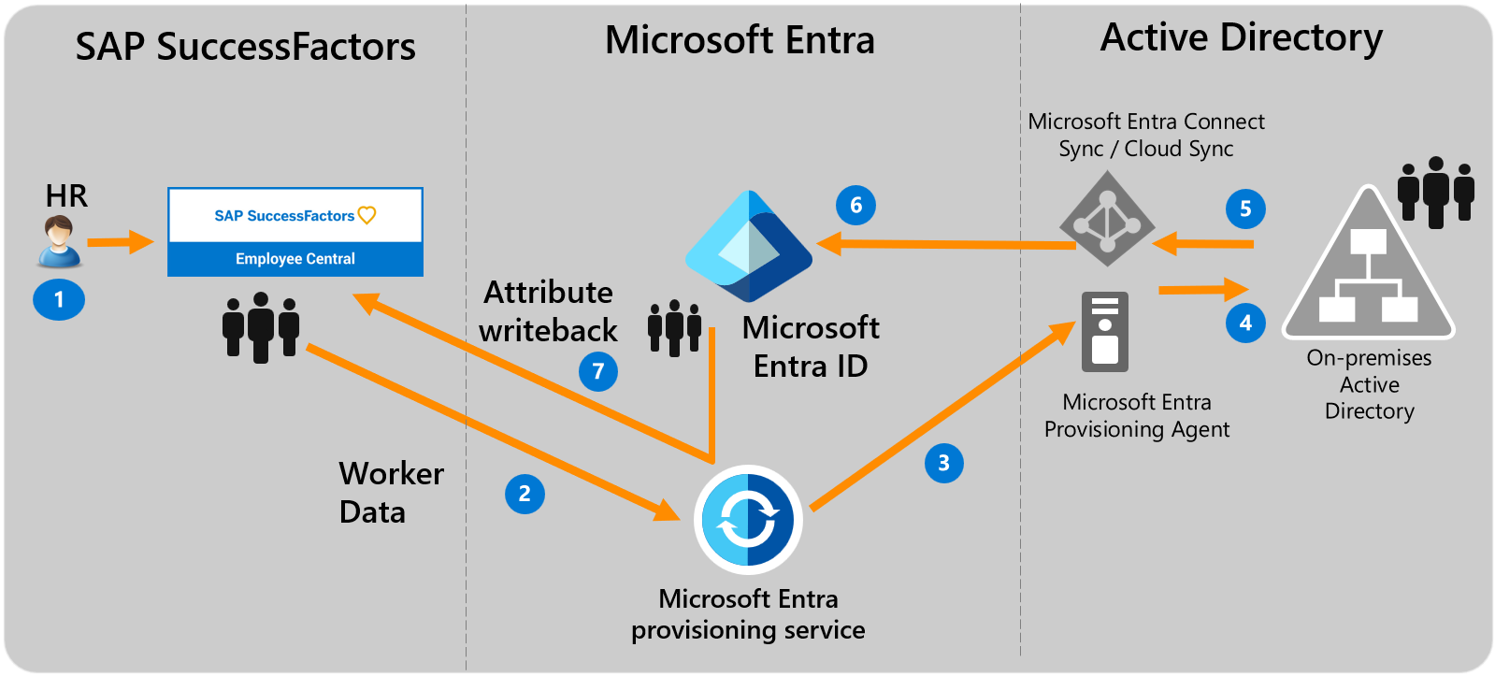
Integrate with HR Sources – SAP SF + AD DS (Hybrid Identity)

Slide 25
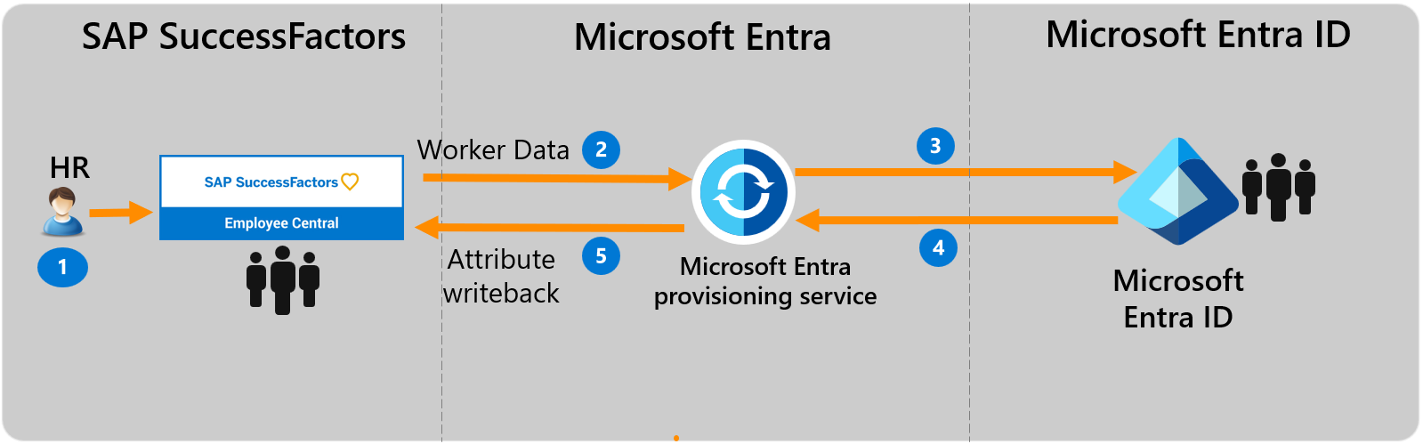
Integrate with HR Sources – SAP SF + Entra ID (Cloud-only)

Slide 26
Migrate User Management Scenario
IT Administrators uses Microsoft Entra Admin Center, Microsoft Graph API or PowerShell to perform day-to-day identity management activities such as:
User management*
Group Management*
Provisioning (HR Inbound, Target App)
Access Policies and Entitlement Management
Audit, Monitoring and Reporting
* For Hybrid environments with On-Premises Active Directory, AD Admin Center, ADUC or PowerShell and are the main tools

Slide 27
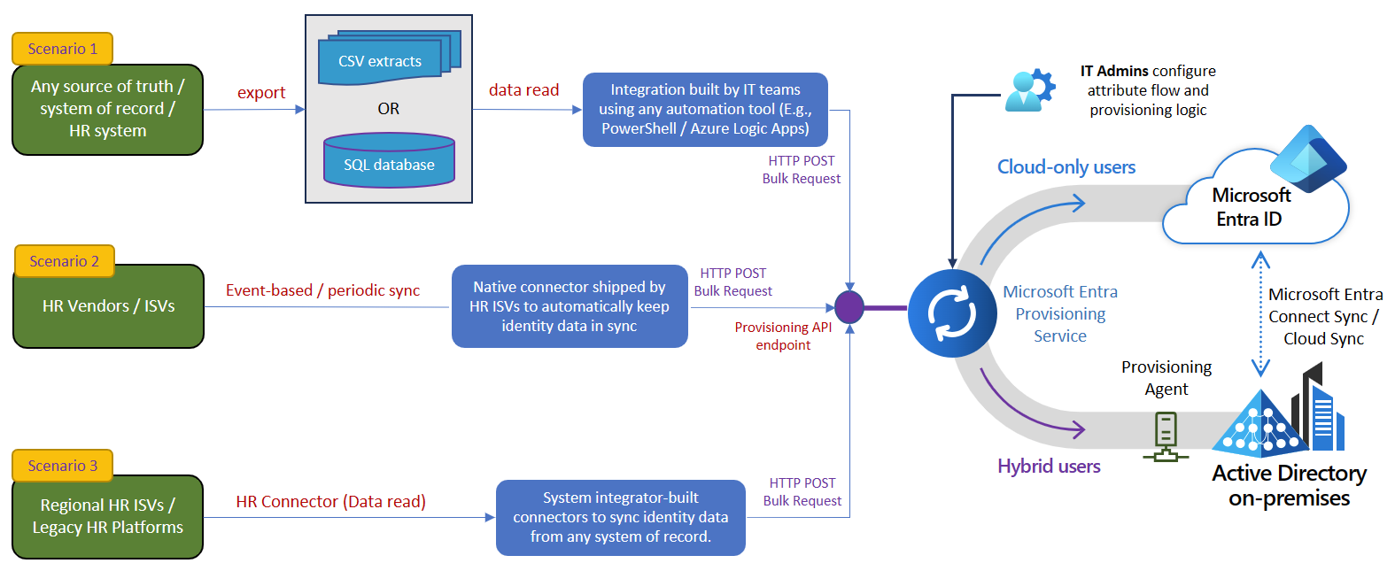
Integrate with Other HR Sources – API-Driven

Slide 28
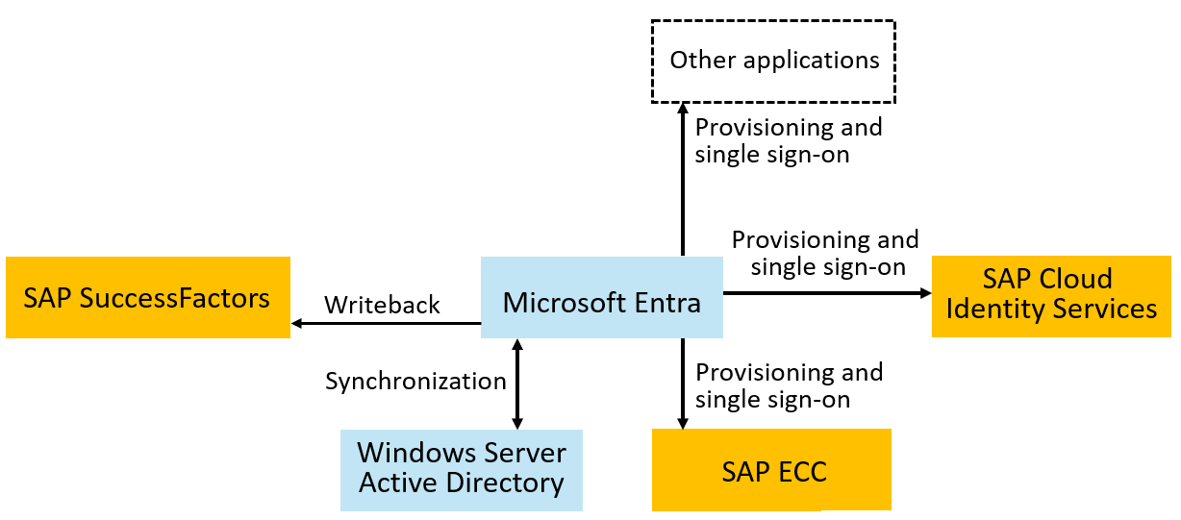
Provision to SAP systems
Microsoft has connectors to SAP ECC, SAP Cloud Identity Servers and
Other SAP and non-SAP systems.

Slide 29
Provision to SAP systems – SAP Cloud Identity Services
For SAP Cloud Identity Services, confirm the SAP Cloud Identity Services have the necessary schema mappings for those applications, and provision the users from Microsoft Entra ID to SAP Cloud Identity Services.
SAP Cloud Identity Services will subsequently provision users into the downstream SAP applications, as necessary.
You can also automate changes to the application role assignments in Microsoft Entra ID for SAP Cloud Identity Services.

Slide 30
Provision to SAP systems – On-Premises SAP ECC
For SAP ECC, confirm that the necessary Business APIs (BAPIs) for SAP ECC are ready for Microsoft Entra to use for identity management, then provision the users from Microsoft Entra ID to SAP ECC.
If you are using SAP NetWeaver AS for Java with Windows Server Active Directory as its data source, then Microsoft Entra SuccessFactors inbound can be used to automatically create and update users in Windows Server AD.
If you are using SAP NetWeaver AS for Java with another LDAP directory as its data source, then you can configure Microsoft Entra ID to provision users into LDAP directories.

Slide 31
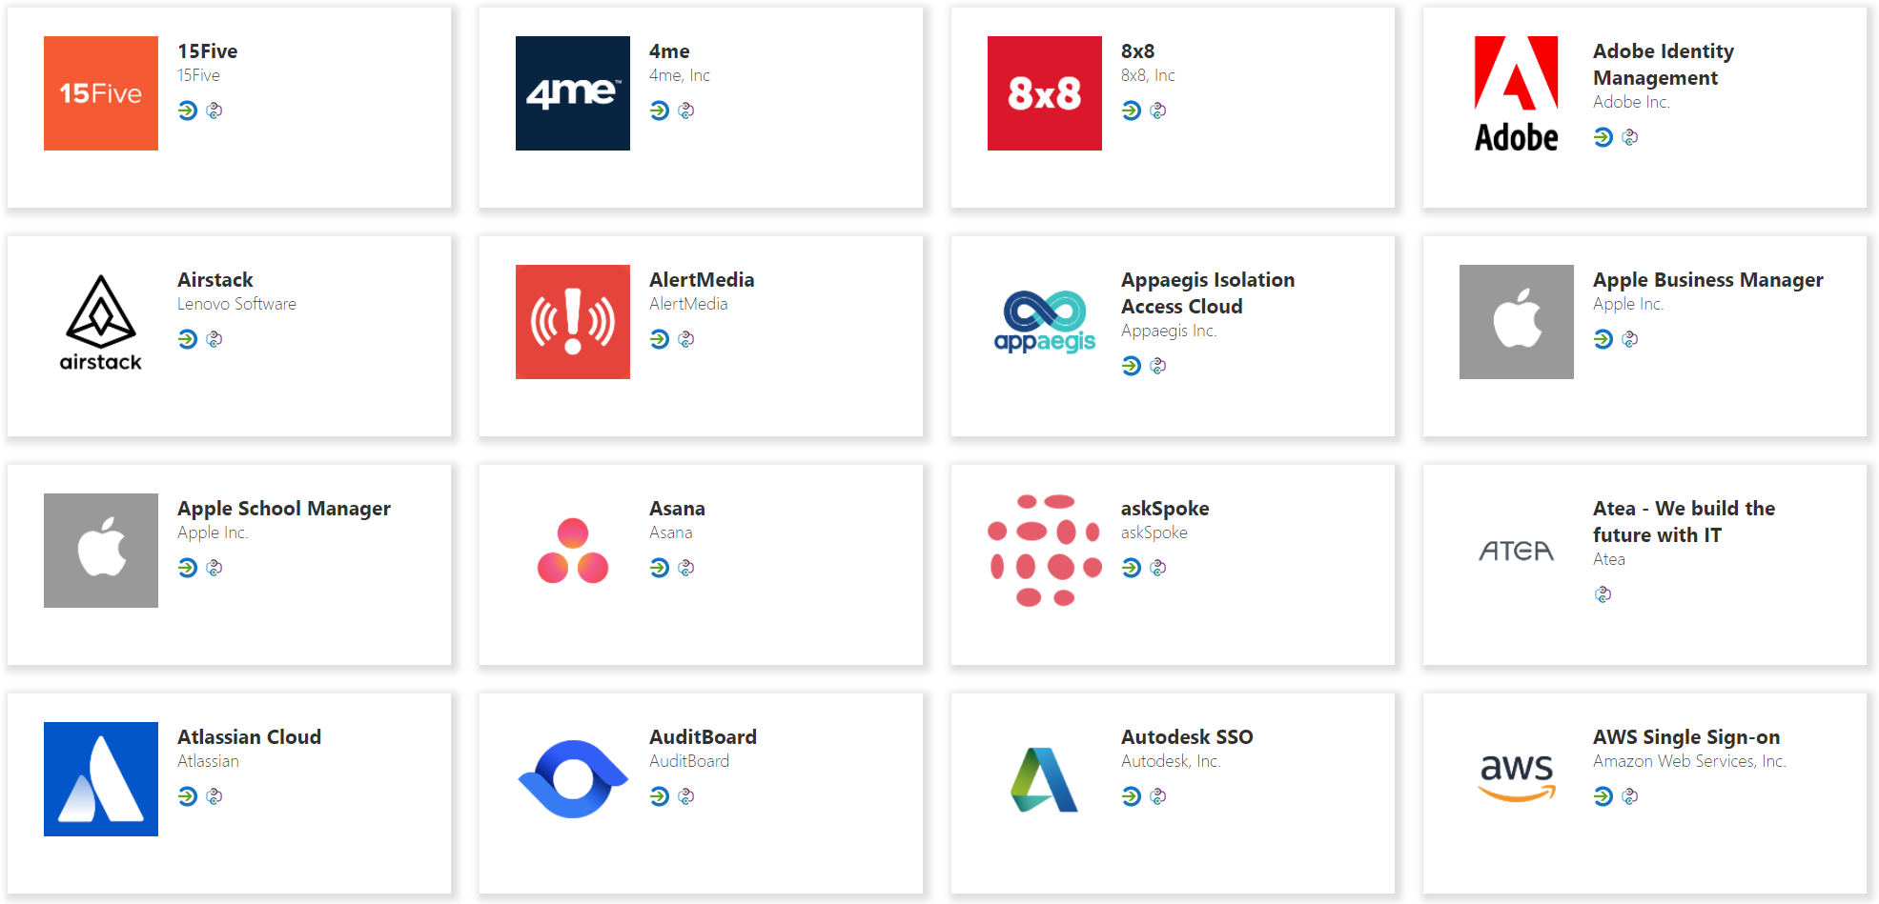


Provision to non-SAP Systems – SaaS
Entra Provisioning service connects to 3rd party apps via SCIM endpoints for user management
Automatically create, update or deactivate accounts in applications.
Ensure that the identities in your apps and systems are kept up to date based on changes in the directory or your human resources system.
Provision groups to applications that support them.
Take advantage of customizable attribute mappings that define what user data should flow from the source system to the target system.
Monitor and audit who has been provisioned into your applications.
The provisioning service provides alerts for critical events and allows for Log Analytics integration where you can define custom alerts to suit your business needs.
Microsoft
Entra ID
SaaS applications

Slide 32




Provision to non-SAP Systems – On-Premises
Users and schema defined in the cloud
Supports provisioning from custom schema extensions to app-specific properties.
Single sign-on and provisioning
SCIM
Translation to the provisioning protocols expected by apps
Microsoft-delivered connectors: LDAP, SQL, etc.
Ecosystem of third-party connectors for other apps requiring custom API integrations
Customers can re-use their existing MIM configuration
Microsoft Entra
provisioning agents
SOAP
LDAP
PS
SQL

Slide 33
Migrate Authentication and SSO
Microsoft Entra ID acts as a security token service, enabling users to authenticate to Microsoft Entra ID with multi-factor and passwordless authentication, and then have single sign-on to all their applications. Microsoft Entra ID single sign-on uses standard protocols including SAML, OpenID Connect and Kerberos.
We recommend to migrate authentication and SSO capabilities to Microsoft Entra for better security, consistent and user experience
Tutorial: Microsoft Entra single sign-on (SSO) integration with SAP Cloud Identity Services - Microsoft Entra ID | Microsoft Learn

Slide 34
Migrate Authentication and SSO
Tutorial: Microsoft Entra single sign-on (SSO) integration with SAP Cloud Identity Services - Microsoft Entra ID | Microsoft Learn
Tutorial: Microsoft Entra SSO integration with SAP Business Technology Platform - Microsoft Entra ID | Microsoft Learn
Tutorial: Microsoft Entra single sign-on (SSO) integration with SAP HANA - Microsoft Entra ID | Microsoft Learn
Tutorial: Microsoft Entra single sign-on (SSO) integration with SAP Fiori - Microsoft Entra ID | Microsoft Learn
Tutorial: Microsoft Entra single sign-on (SSO) integration with SAP NetWeaver - Microsoft Entra ID | Microsoft Learn
And more…

Slide 35
Migrate user Self-Service
Organizations may have used SAP IDM Logon Help to enable their end users to reset their Windows Server AD password.
Microsoft Entra self-service password reset (SSPR) gives users the ability to change or reset their password, without needing administrator or help desk involvement.
Self-service password reset deep dive
Microsoft Entra also supports end user self-service for group management, and self-service access requests, approval, and reviews.

Slide 36
Migrate access lifecycle management
Organizations may have integrated SAP IDM with SAP AC, formerly SAP GRC, or SAP IAG for access approvals, risk assessments, separation of duties checks and other operations.
Microsoft Entra includes multiple access lifecycle management technologies to enable organizations to bring their identity and access management scenarios to the cloud. The choice of technologies depends upon your organization's application requirements and Microsoft Entra licenses.

Slide 37
Access Management via Security Groups
Microsoft Entra makes group memberships available to applications via SAML claims, provisioning, or by provisioning security groups to WindowsServer AD. SAP Cloud Identity Services can read groups from Microsoft Entra ID via Graph, and provision those groups to other SAP applications.
Administrators can manage group membership, create access reviews of group memberships, and enable self-service group management.
Use Privileged Identity Management (PIM) for groups to manage just-in-time membership in the group or just-in-time ownership of the group.

Slide 38
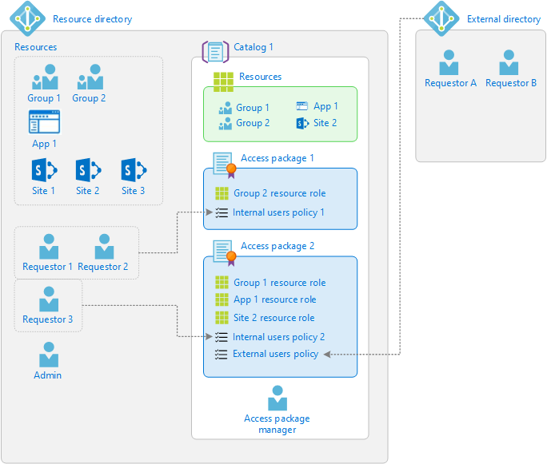
Access Management via Entitlement Management
Entitlement management is an identity governance feature that enables organizations to manage identity and access lifecycle at scale, by automating access request and approval workflows, access assignments, reviews, and expiration.

Slide 39
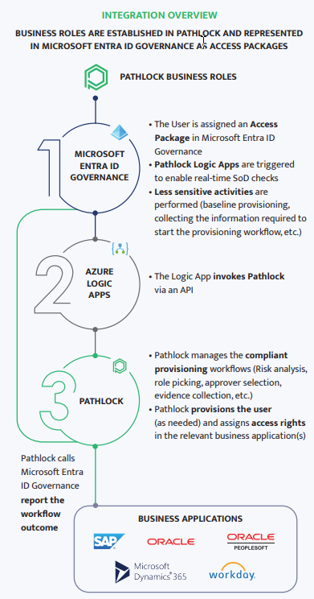
Access Management via Entitlement Management + external GRC product
With the integration from Microsoft Entra ID Governance to Pathlock and other partner products, customers can take advantage of fine-grained separation-of-duties checks enforced in those products, with access packages in Microsoft Entra ID Governance.

Slide 40
Choose a Path
If the customer has | Position
SAP IDM | Microsoft Entra ID + Microsoft Entra ID Governance
SAP IDM + SAP AC (aka SAP GRC) | Microsoft Entra ID + Microsoft Entra ID Governance + SAP AC + SAP Cloud Identity Access Governance (IAG bridges to SAP AC and provides cloud app support) *Using Pathlock can be an alternative to SAP GRC
Pathlock | Microsoft Entra ID + Microsoft Entra ID Governance + Pathlock

Slide 41
Use Microsoft Entra for reporting
Microsoft Entra includes built-in reports, as well as workbooks that surface in Azure Monitor based on audit, sign-in, and provisioning log data
Usage and insights reports for an application-centric view on sign-in data.
Monitor for unusual account creation and deletion, and unusual account usage.
Query Microsoft Graph to obtain data for use in a report. For example, you can retrieve a list of inactive user accounts in Microsoft Entra ID.

Slide 42
Use Microsoft Entra for reporting
You can export data from Microsoft Entra admin center for use in generating your own reports. For example, you can download a list of users and their attributes or download logs, including the provisioning logs, from the Microsoft Entra Admin Center.
You can create custom reports with Azure Data Explorer, PowerBI or other tools you are familiar with.
You can use the PowerShell cmdlets atop Microsoft Graph APIs to export and restructure content suitable for reporting.

Slide 43
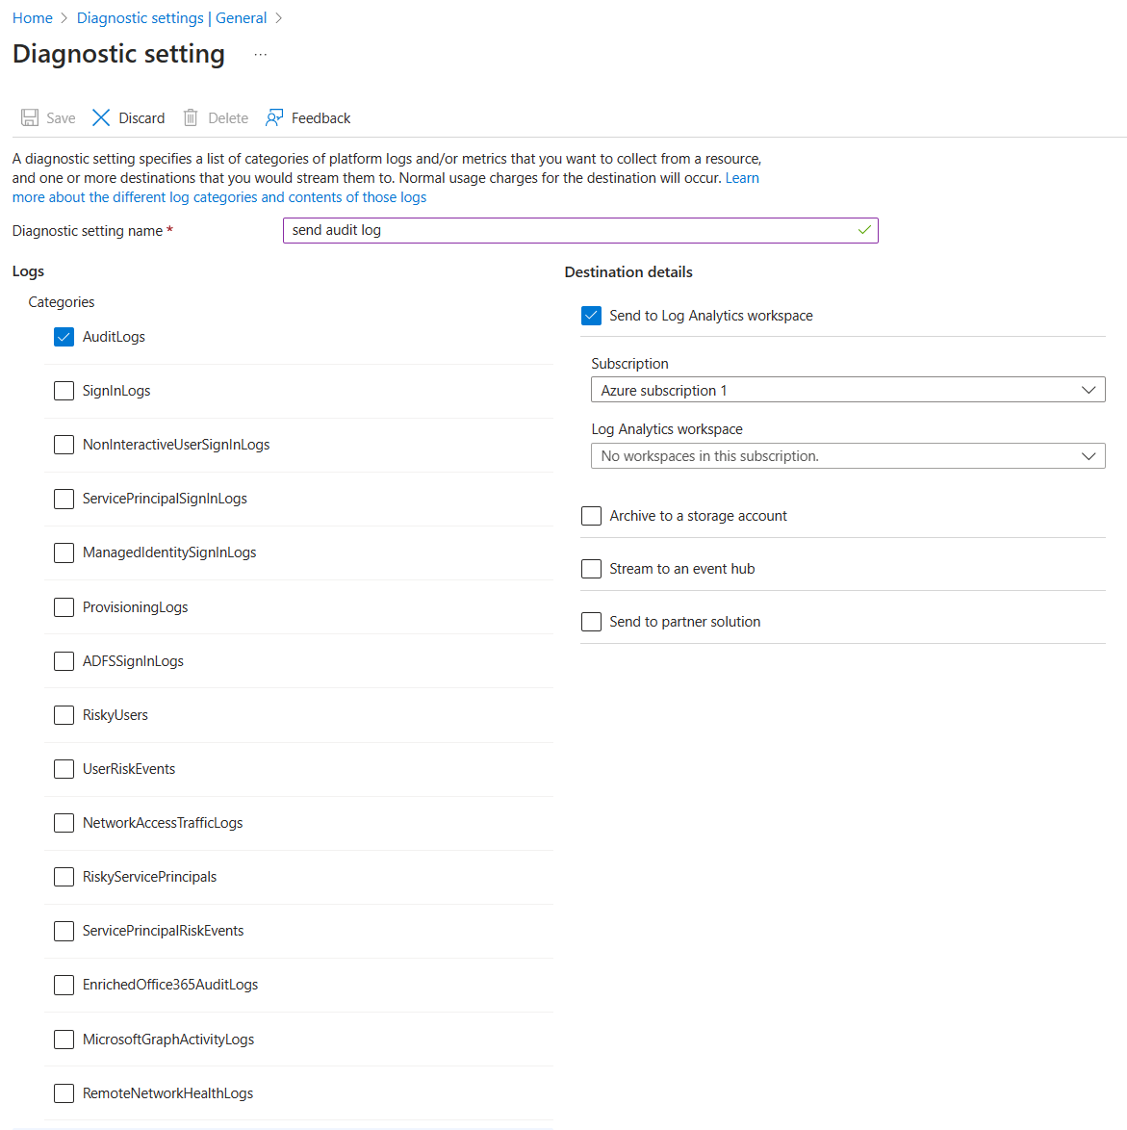
Use Microsoft Entra for reporting
Export data for SIEM, Azure Monitor or other storage solutions
Archive & report with Azure Monitor - Entitlement Management Reporting

Slide 44
Migrate Identity Federation (B2B)
Some organizations may be using SAP IDM identity federation to exchange identity information about users across company boundaries.
Microsoft Entra (B2B) can connect with different organizations (SAML/OIDC) for collaboration
Microsoft Entra includes capabilities for a multitenant organization, that more than one Microsoft Entra ID tenant, to bring together users from one tenant for application access or collaboration in another tenant.

Slide 45
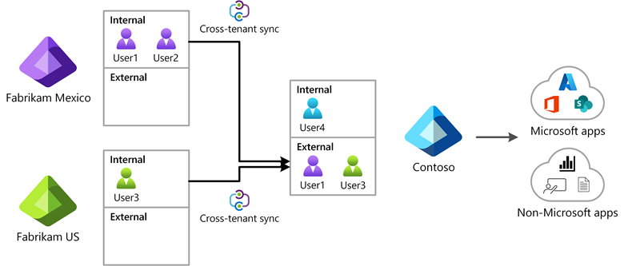
Migrate Identity Federation (B2B)
Microsoft Entra External ID includes B2B collaboration capabilities that allow your workforce to work securely with business partner organizations and guests and share your company's applications with them.

Slide 46
Migrate Identity Federation (B2B)
Microsoft Entra ID can provision and provide SSO capabilities for B2B Guest users to SAP Applications, such as SAP Cloud Identity Services
Lifecycle of B2B Guest users can be managed using Self-Service Sign-Up and Entitlement Management to govern the identity and access lifecycle for those external users.

Slide 47
Migrate applications requiring directory services
Some organizations may be using SAP IDM as a directory service, for applications to call into to read and write identities.
If you are using Microsoft Entra to populate workers from SuccessFactors into on-premises Active Directory, then the applications can read users and groups (with Group Writeback) from that Windows Server Active Directory.

Slide 48
Migrate applications requiring directory services
If your app is running on Azure, you can consider Microsoft Entra Domain Services, for Apps compatible with AD DS environment.
If your organization has been using another LDAP directory, then you can configure Microsoft Entra ID to provision users into that LDAP directory.

Slide 49
Extend Microsoft Entra through integration interfaces
Applications can call Microsoft Entra via the Microsoft Graph API to query and update identity information, configuration and policies, and retrieve logs, status, and reports.
Administrators in a tenant with Microsoft Entra ID Governance can also configure calls to custom Azure Logic Apps from entitlement management and lifecycle workflows. These allow customization of the user onboarding, offboarding, and access request and assignment processes.
Custom connectors are available via Services and integration partners

Slide 50
License Requirements
To successfully transition from SAP IDM to Microsoft Entra ID for comprehensive identity, provisioning, and access management governance, customers will need to acquire the following licenses:
Microsoft Entra ID P1 + Microsoft Entra ID Governance or Microsoft Entra Suite
Front-Line Workers licenses are also available
Customers can enable 30-days trial of Microsoft Entra ID Governance

Slide 51
Recommended actions
Learn more about Microsoft Entra ID Governance: https://aka.ms/entra/identitygovernance
View the Microsoft Mechanics video: https://aka.ms/IDGovMechanics
Walk through the Interactive Guides: https://aka.ms/EntraIDGovGuides
Read documentation: https://aka.ms/Entra/IDGovDocs
Set up a free trial: https://aka.ms/EntraTrialsPage
Read SAP IDM Migration guide: https://aka.ms/MigrateFromSAPIDM
Plan deploying Microsoft Entra for user provisioning with SAP source and target apps

Slide 52
Thank you

